Slide 1
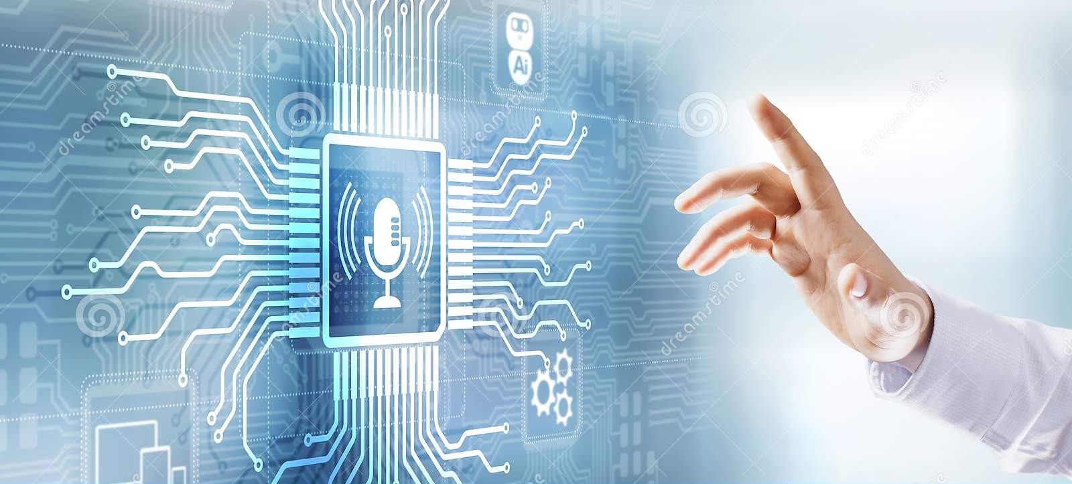

Innovative Deep Learning Models for Speech Recognition
Meghana Udiga

Slide 2
Contents
Abstract
Introduction
Exploring Applications and Advancements
Neural networks
Popular Implementations of Neural Networks in Virtual Assistants
Anticipating Future Developments and Overcoming Limitations
Conclusion

Slide 3

Abstract
Deep learning models have been instrumental in voice recognition technology, particularly in terms of accuracy. This study compares the effectiveness of contemporary voice assistants with various deep learning models for speech recognition, including DNN, DBN, and RNN. It also looks at the field's potential advancements and limitations. Speech recognition technology has made great strides, and more study and development is expected to result in major enhancements in functionality, accuracy, and dependability.

Slide 4

introduction
Speech recognition is an important technology for human-computer interaction (HCI). It involves turning a vocal signal into a string of words, and has been the subject of computer science research since the 1960s. Machine speech recognition has a wide range of uses, such as virtual reality, multimedia searches, auto-attendants, travel planning and reservations, translators, and NLU. This research paper examines deep learning models for speech recognition, their efficacy, difficulties and constraints, commercial uses, and potential for use in the future.

Slide 5

Exploring Applications and Advancements
Healthcare: automating administrative tasks and transcribing medical dictations
Transportation: enhancing safety and allowing hands-free tasks
Security: authentication based on voiceprint
Customer service: improving customer experience with voice-activated automated systems
Finance: automating financial operations and providing real-time advic
Retail: improving customer service and inventory management with voice commands

Slide 6
Neural networks
Neural networks are mathematical models that mimic the functioning of the human brain, allowing them to learn to recognize patterns, make predictions, and classify data
DNNs use hidden layers between input and output layers to learn more complex and abstract representations of data, which can be useful in a variety of applications.
RNNs are powerful neural networks that can handle sequential data by retaining an internal state that encodes information about past inputs, allowing them to make predictions or classifications based on the complete sequence context.
Deep Belief Networks (DBNs) are a class of deep neural networks constructed from multiple layers of Restricted Boltzmann Machines (RBMs). They excel at tasks such as feature learning, classification, and dimensionality reduction by learning hierarchical representations of data.

Slide 7
Popular Implementations of Neural Networks in Virtual Assistants
Google Home uses automatic speech recognition and neural network models for natural language processing, with multichannel processing and Grid-LSTMs for frequency fluctuations. It requires an internet connection for cloud computing.
Siri is an Apple virtual assistant powered by a deep neural network, capable of various tasks such as making calls and setting reminders.
Amazon's Alexa is a voice-activated AI gadget that uses cloud-based deep neural networks and a two-step neural shortlisting-reranking approach to select the most relevant skill.

Slide 8

Anticipating Future Developments and Overcoming Limitations
Advancements in natural language processing, machine learning, and speech recognition are expected in the coming years for voice-based AI systems like Siri, Alexa, and Google Home. However, these systems have limitations that need to be addressed. Offline functionality could be improved, user controls and privacy regulations could be enforced, and more sophisticated security mechanisms could be implemented. Further research and development could lead to more complex algorithms and models that are less reliant on internet access and provide better user privacy protection.

Slide 9
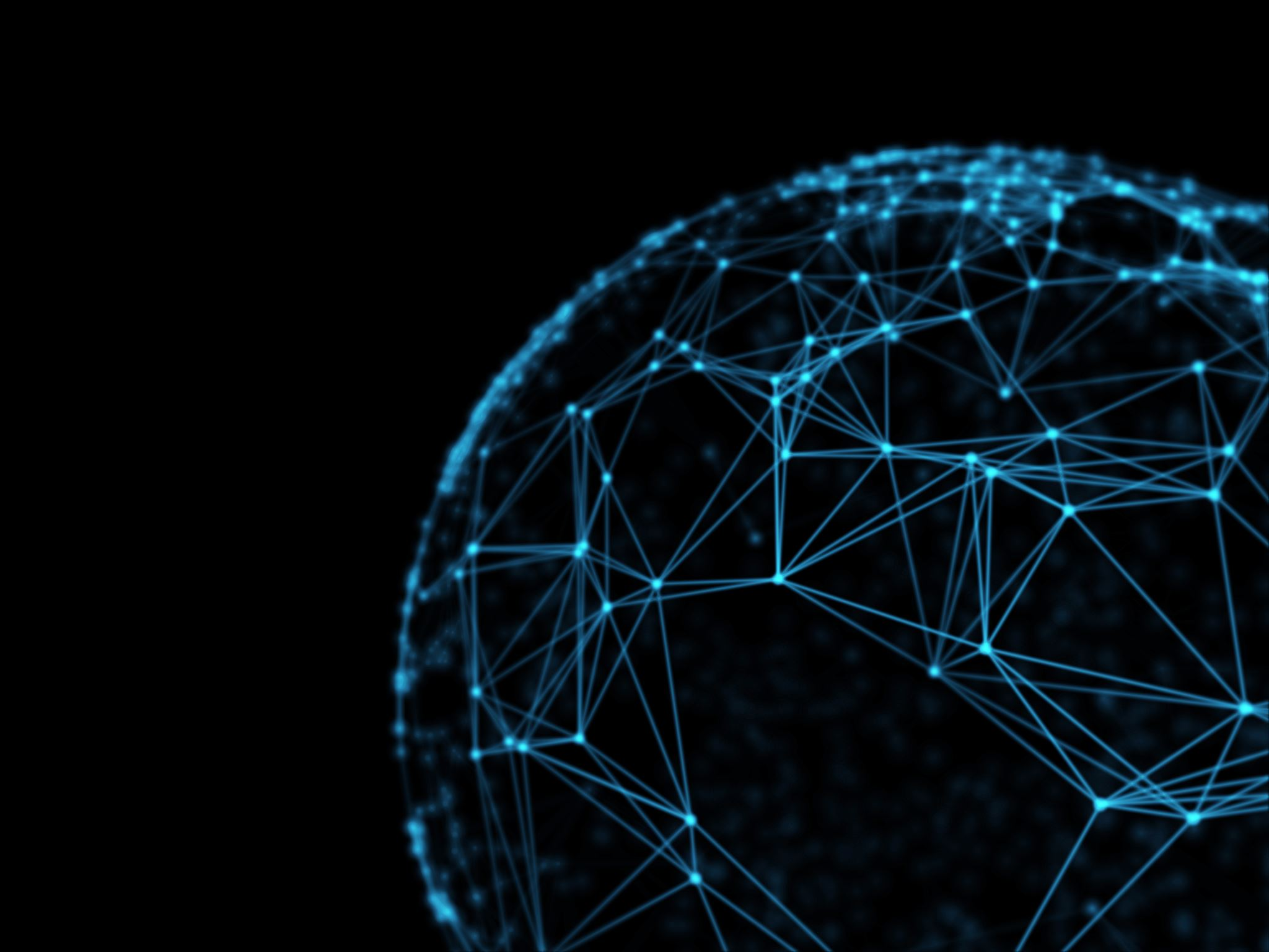
conclusion
Deep learning and neural networks have made voice recognition technologies more precise and reliable, leading to a wide range of new applications in industries such as healthcare, transportation, security, and customer service. Speech recognition is being used to automate operations, increase safety, and improve the customer experience in a variety of industries. The potential for speech recognition technology to change how we live and work is exciting.

Slide 10
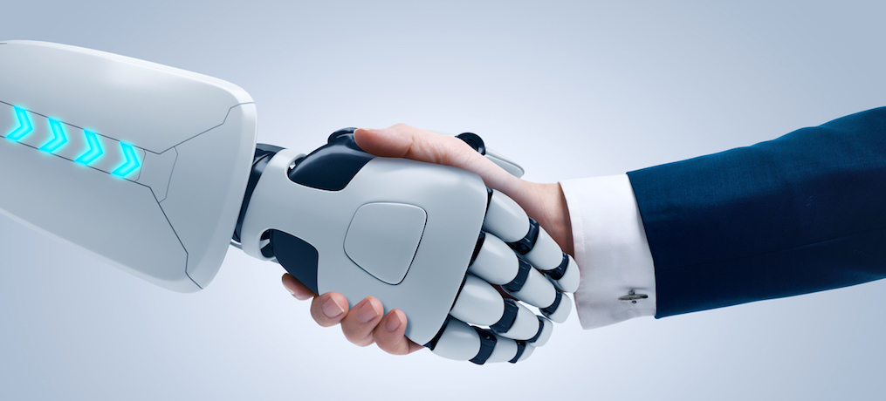
THANK YOU

